Slide 1
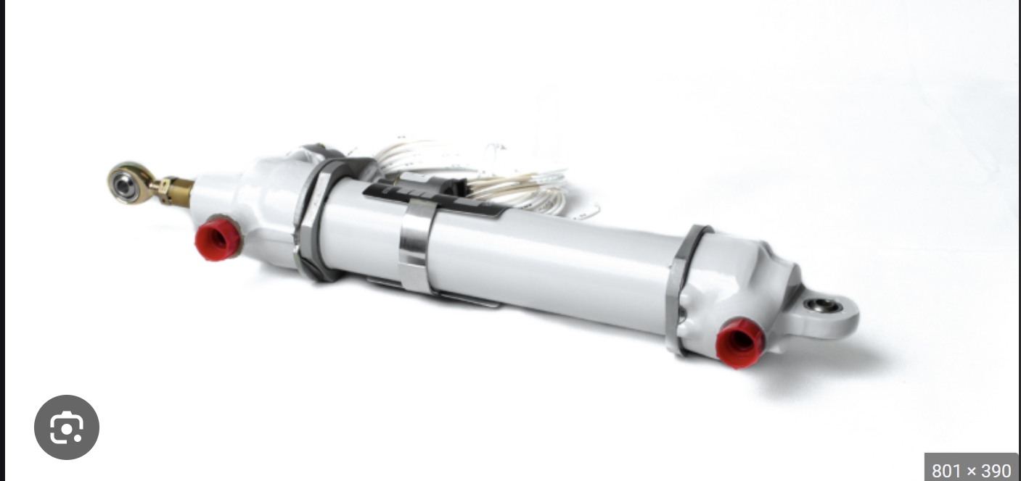
Thermal Expansion of a Bar Case Study
By: Scott Lee
Date: 03/11/25

Slide 2
Introduction
The main intent of this example is to:
1) Perform a case study of a bar with Fixed-Fixed Boundary conditions under thermal loading
2) Apply Some Compliant CBUSHES at the end of the bar to study the change in bar forces under thermal loading

Slide 3
Equations to Determine Internal Force within the Bar (Fixed-Fixed BC)
σ = E × ε
Where:
σ = Stress
E = Young's Modulus (Elastic Modulus)
ε = Strain
Inputs
E = 29.0e6
A = 0.5 in^2
α = 6.6e-6
ΔT = 100 F
P = E x A × α × ΔT
P/A = E × ε
P = 29.0e6 x 0.5 x 6.6e-6 x 100 = -9570 LBS (in compression)
Notes:
Internal force is in a state of compression whenever there is a Hot Thermal Load
  This makes sense, as the bar wants to “expand” due to a Hot Thermal load, but due to the Fixed-Fixed BC, it is prevented from expanding, therefore an internal compressive force will be developed within the bar member
The internal axial force is not a function of the length of the bar
ε = α × ΔT
Where:
ε = Strain (change in length per unit length, ΔL / L₀)
α = Coefficient of linear thermal expansion
ΔT = Change in temperature (T_final - T_initial)

Slide 4

Illustration
Fixed at Both Ends
Apply a Hot Thermal Loading
Orange bar will want to expand. However, it is prevented from expansion due to the Boundary Condition. Therefore, there will need to be a compressive force internal to the bar

Slide 5
Determine Bar Forces with Compliant Springs at the Ends of the Bar
Springs in Series
For springs in series, the equivalent spring constant (k_eq) can be calculated using the following equation:
1/k_eq = 1/k₁ + 1/k₂ + 1/k₃ + ... + 1/kₙ
Where:
k_eq is the equivalent spring constant for the series combination
k₁, k₂, k₃, ..., kₙ are the spring constants of the individual springs
n is the number of springs connected in series
This equation comes from the fact that in a series configuration, the total displacement (stretch or compression) of the system is the sum of the displacements of each individual spring, while the force applied is the same across all springs.
Example:
If you have two springs in series with constants k₁ = 10 N/m and k₂ = 20 N/m:
1/k_eq = 1/10 + 1/20
1/k_eq = 0.1 + 0.05 = 0.15
k_eq = 1 / 0.15 ≈ 6.67 N/m

Slide 6
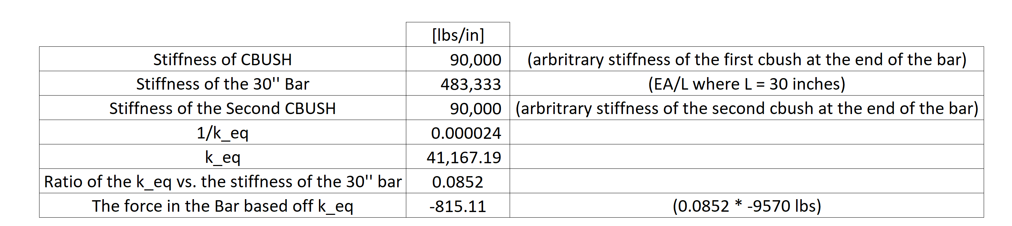
Force in Bar when Applying Compliant Springs at the Ends of the Bar due to Thermal Loading
Summary:
An idealized “fixed-fixed” boundary condition leads to high development of bar forces (-9570 LBS).
  In the real-world, this is not realistic and an overly conservative assumption
In reality – for example, for an actuator with structural components attached to each of the sides of the actuator, the load development in the actuator will be closer to a bar with springs modeled at the two ends of the bar, as shown in the second example.

